Slide 1
XAML for Windows 10: Layout
Daren May | President, CRANK211
Jerry Nixon| Developer Evangelist, Microsoft

Slide 2

Meet Daren May | ‏@darenmay
Daren May is the President and co-founder of Crank211 — a company that specializes in designing and building next-level digital experiences.
Daren has written and presented a number of MVAs and spoken at Microsoft Ignite. He has been developing XAML-based solutions since the heady days of “Avalon” (the early name for WPF).

Slide 3


Meet Jerry Nixon | ‏@jerrynixon
Microsoft Developer Evangelist
Reaching Professional & Student Communities
Teaching Developers about Windows
Teaching Developers about XAML
Author of Template 10
http://jerrynixon.com

Slide 4
Course Topics
XAML for Windows 10: Layouts
01 | Layout Fundamentals | 03 | Effective Layouts
02 | Custom Panel

Slide 5
Setting Expectations
Target Audience
Developers looking to make apps for Windows 10
Suggested Prerequisites/Supporting Material
Basic C# knowledge
Basic XAML

Slide 6
Recommended Resources
https://dev.windows.com/
MSDN Custom Panel Resource
https://msdn.microsoft.com/en-us/library/windows/apps/xaml/mt228351.aspx

Slide 7
02 | Custom Panels

Slide 8
Module Overview
Custom Panel Basics
Building a Custom Panel

Slide 9
Custom Panel Basics

Slide 10
Why build a custom panel?
Notes:
SIGNAURE LAYOUT OR EXPERIENCE

Slide 11
Do you really need a custom panel?

Slide 12
What about this?
Notes:
SIGNAURE LAYOUT OR EXPERIENCE / bring up Radial

Slide 13
Derive from Panel
Derive from Panel (or a more specific panel such as Grid)
Inherits
Children
Background, ChildrenTransitions and ItemsHost
Typically unchanged
Override and implement (most work here)
MeasureOverride - not override Measure()
ArrangeOverride - not override Arrange()

Slide 14
Children
UIElementCollection (IList<T>)
Stores contained child elements
Children.Count may be useful in your layout algorithm

Slide 15
Layout Methods
Measure
Arrange
There are two panel phases:
Measure
Arrange

Slide 16
Measure Phase
Page calls Panel.Measure – passing available size
Panel calls each Child.Measure (recursively) – passing available size
Child returns to Panel its Desired Size
Panel calculates layout – resulting in Desired Size
Panel returns to Page its Desired Size
Implemented in MeasureOverride
Query each child for DesiredSize
By calling their Measure method
Determine your DesiredSize
This is a product of your unique layout
Do not call base.MeasureOverride();
It has not native implementation

Slide 17
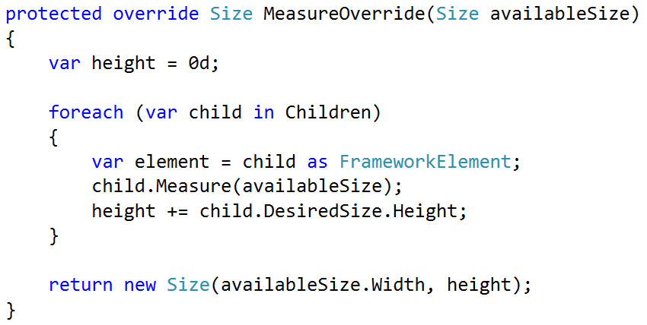
Panel.MeasureOverride(Size)

Slide 18
Arrange Phase
Page calls Panel.Arrange – passing final size and location
Panel calls each Child.Arrange (recursively) – passing final size and location
Panel calculates layout using Final Size
Implemented in ArrangeOverride
Determine each child’s location (x, y)
Calls child’s Arrange method
This ensures the child is rendered
Do not call base.ArrangeOverride()
Notes:
Your panel may have to force size restrictions on children
Children may need to be clipped

Slide 19
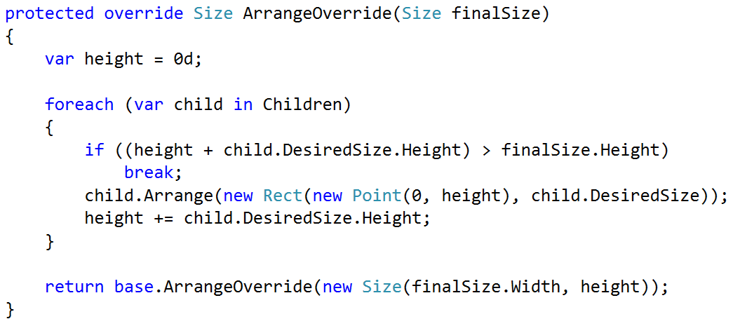
Panel.ArrangeOverride(Size)

Slide 20
Custom Panel Demo

Slide 21
Custom Panel Demos
Notes:
Stack Panel
HorizontalAlignment
Add Button / Transitions
* Column Panel

Slide 22
Summary
Custom Panel Basics
MeasureOverride
ArrangeOverride
Building a Custom Panel

